Slide 1
Stewardship Expectation 1
Good Practice Template
Notes:
Please refer to the supporting NSTA JV Hub Strategy Good Practice Guide for additional supporting information to this template pack.
NSTA Stewardship Expectation 1 (Joint Venture Hub Strategy) should also be referred to when populating this template pack – https://www.nstauthority.co.uk/media/5895/oga_se1_joint_hub_strategy_july_2019.pdf
Not all slides will be applicable, therefore please refer to slide 22 (JV Hub Strategy – Good Practice Matrix) which provides a guide on which slides are applicable dependent on the lifecycle stage of the assets/hub in question.
This template should be treated as a guide and all slides can be adjusted by the Operator as necessary to suit their asset/hub.
The Operator can add additional slides where necessary to support their JV Hub Strategy.
Multiple copies of each template slide can be used if necessary to provide further detail.
All graphics/figures throughout the slide pack are provide as guidance, the operator can replace with any specific/relevant graphics which best describe the corresponding section of the strategy.
This slide can be updated by the Operator with appropriate company logos and graphics to appropriately represent the asset/hub.

Slide 2
[Hub Name]: Hub Strategy Revision History
[Hub Name]: Update Table Below with Key Revision History
Revision Date | Revision Number | Key Changes/Updates Since Last Submission
31/01/24 | Rev 4 | Further information provided with regards Decom Preparation & Post CoP Options? Developed Life Extension Opportunities slide? Updated SWOT Analysis following JV OCM/TCM?
31/10/23 | Rev 3 | Updated OPEX/CAPEX/ABEX following recent JV plan/budget approvals? Updated Hub Timeline following Hub JV life of field workshop? Added details on new infill well and workover opportunities?
31/08/23 | Rev 2 | 3rd Party/Business Development Opportunities slide following recent BD engagement? Updated Barrel Adding Opportunities slide following recent well intervention updates? Updated Shutdown Strategy for Hub Name XXX?
28/02/23 | Rev 1 | Updated Hub Strategy 1 Page Summary following JV OCM/TCM? Updated Emissions slides following latest ERAP submission? Added new Exploration Opportunity (New Field XXX)?
EXAMPLE
Notes:
This slide should be used to capture key changes for the JV Hub Strategy

Slide 3
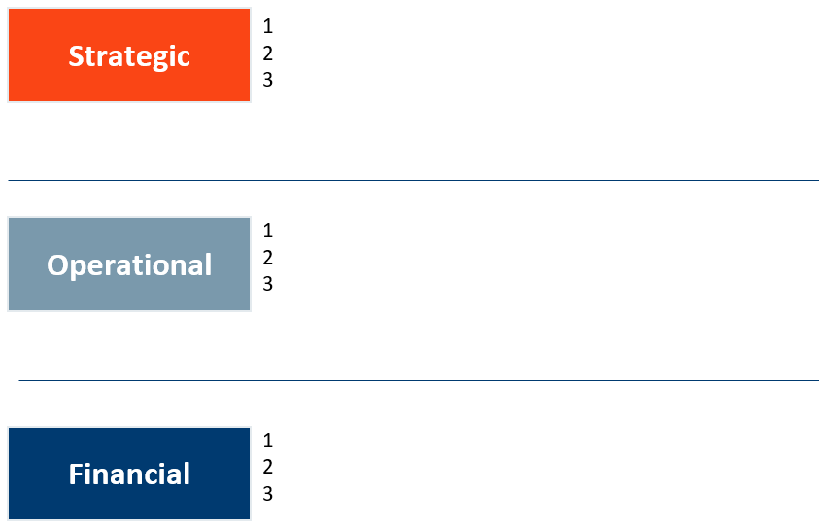
[Hub Name]: Hub Strategy 1-Page Summary
[Hub Name]: Mission Statement: xxx
Insert Appropriate Summary Picture
Field Map
Hub + Tie-Backs
Prospects, Discoveries & Fields in 30km Radius
Licence Acreage Held by JV
EXAMPLE
EXAMPLE
[Hub Name] Strategic Intent (e.g. Key Strategic Points):
Hub Timeline
SWOT Analysis
MAH Prevention/Process Safety
Emissions Baseline, Forecasts & Targets
ERAP Program & Investments
MER – Exploration Prospectivity, Undeveloped Discoveries, Infill/Workover Opportunities & Enhanced Recovery Opportunities
3rd Party/Business Development Opportunities
Topsides Projects (inc. ERAP)
Barrel Adding Opportunities
PE/Debottlenecking Opportunities
Shutdown/TARs/Maintenance Backlog
Life Extension Opportunities
Technology Requirements
OPEX/CAPEX/ABEX
Decom Prep & Post CoP Options
JV Collaboration & Alignment
Development Scenario Analysis
EXAMPLE
Notes:
Summary Picture – an appropriate summary graphic should be provided which adequately shows the asset/hub (e.g. Field Map including installations, tie-backs, future prospects, licences).
Strategy Summary – graphic or bullet points to provide a high level summary of the asset/hub long term strategy.
Production Graphic – an appropriate graphic summarising the production for the asset/hub including future resource progression opportunities.
Emissions Graphic – an appropriate graphic summarising the emissions for the asset/hub including reduction opportunities, ERAP commitments, increases associated with new opportunities, emissions intensity.
Strategic Intent Bullet Points – selected bullet points which summarise forthcoming slide in the pack (e.g. key activities associated with long term strategy for the asset/hub).

Slide 4
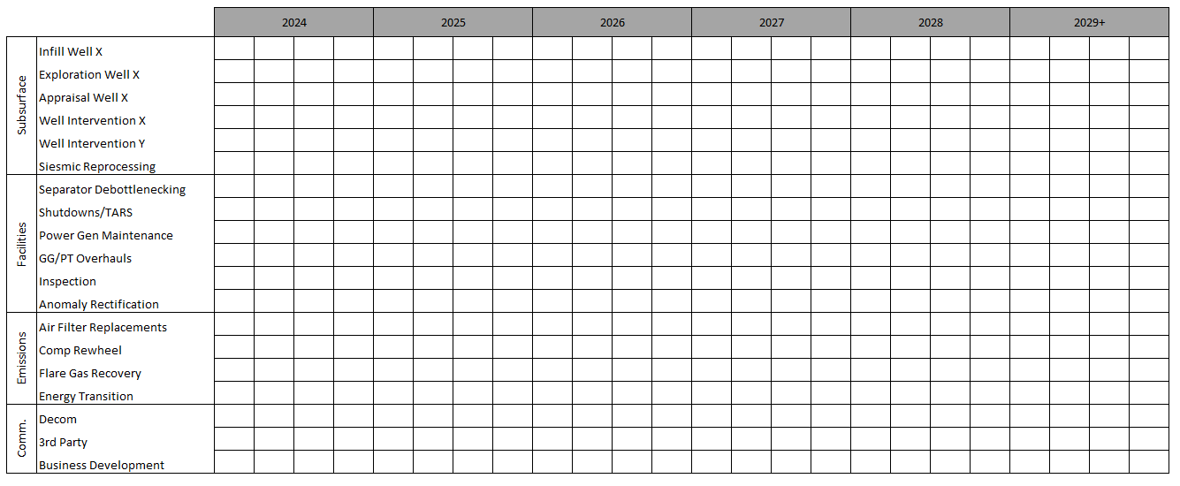
[Hub Name]: Hub Timeline
[Hub Name]: Multi Scenario Plan
Both Strategies
Growth
Harvest & Decom
Drill 2 Wells
LLI’s
FID
Drill 1st Well
1st Oil
CT Campaign 1
CT Campaign 2
3D/4D Processing
FID
LLI’s
Execute
14
7
14
42
7
21
14
A
B
A
GG
GG
Red/Amber Risks
Red Risks Only
Red/Amber Risks
Air Filter Replacements
Comp Rewheel
Flare Gas Recovery
Identify Opportunities
Decom Start
Decom Start
Identify Opportunities
Notes:
This slide should be updated to include a long term plan/timeline for the asset/hub in alignment with the strategy of the asset (as shared in slide 1)
If possible, please include multiple scenarios for the asset/hub.
It is important to include both opportunities to maximise economic recovery and emissions reduction activities.
Multiple copies of this slide could be used for more complicated scenarios/alternatives.

Slide 5
[Hub Name]: SWOT Analysis
[Hub Name]: Summarise Below
[Hub Name] Strengths
[Hub Name] Weaknesses
Consistent JV Engagement?
Partner Alignment on Hub Strategy?
Strong Operator Experience on Assets/Hub?
High Asset/Hub Efficiency/Availability?
Low Unit Operating Cost?
Emissions Reductions/ERAP Commitments?
Management of Emissions Reductions?
Limited Scope for Further Resource Maturation?
Lack of Drilling Rig on Hub following Next Infill Well?
Timing of Potential Well Failures Unknown?
Weak Points in Onshore Infrastructure?
Commercial Challenges with Onshore Reception Facilities?
Challenges on Delivery of ERAP Commitments?
Electrification is not compatible for late life asset?
EXAMPLE
[Hub Name] Opportunities
[Hub Name] Threats
Synergies with Other Assets/Hubs?
Further JV Exploration Bids in Licence Rounds?
Potential Further 3rd Party Tie-Back Opportunities Near Hub
Investing in Energy Efficiency
Electrification/Energy Integration Development
Licence to Operate Could be Challenged
Volatile Commodity Prices
Reception Facilities Cost and Longevity?
Asset Life Extension Could Impact Net Zero Commitments?
Supply Chain Challenges?
Notes:
This slide should be updated to demonstrate the key strengths, weaknesses, opportunities & threats for the asset/hub.
The bullet points provided in the template are a guide and can be included or deleted as necessary.
The Operator should consider the necessary actions to mitigate the identified weaknesses and threats from the SWOT Analysis.

Slide 6
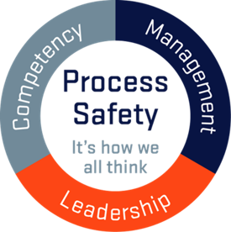
[Hub Name]: MAH Prevention/Process Safety
[Hub Name]: MAH Prevention/Process Safety
Deliberate focus on process safety, supported by Board HSES Committee​
Consistent message from senior leadership​
Simplify the language and remove complexity in terminology​
Process safety management relates to all major accident hazards​
Introduce simple and clear process safety branding using the Process Safety Fundamentals​
Raise process safety awareness, understanding and competency “from the boardroom to the frontline”​
Develop organisational “chronic sense of unease”​
EXAMPLE
EXAMPLE
Notes:
The purpose of this slide is for the Operator to provide a summary of the MAH prevention and/or process safety aspects of the asset/hub.
The bullet points and graphics in the template slide are provided as a guide and should be changed/updated by the Operator for those applicable to the asset/hub.

Slide 7
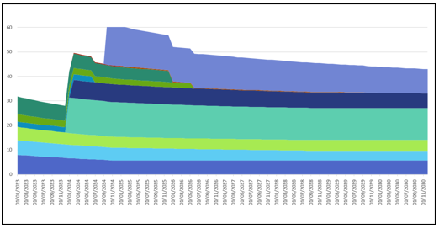
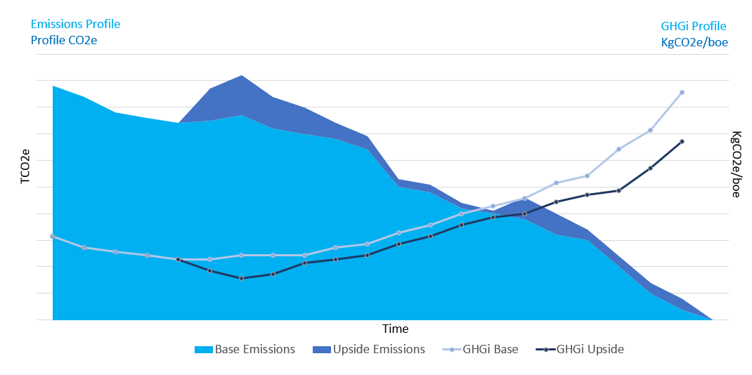
[Hub Name]: Emissions Baseline, Forecasts and Targets
[Hub Name]: Summarise Below
Appropriate Summary Graphic (e.g. Emissions Profile for different Asset Scenarios / Projects
[Hub Name] Emissions Reduction Plan:
LoF emissions & intensity forecast trends with/ without ERAP projects underpinning since 2018 benchmark
Credible emission targets tabulated over short/ medium/ long term
Reference 2018 emissions baseline for the asset/hub
Reference NSTD targets for the asset/hub
xxx
EXAMPLE
Emissions Profile (inc. Upside Emissions)
Projects | Abatement Type | Emissions (CO2e t/yr) | Timing
Compressor Rewheel | Energy Efficiency | -2000 | QX 20XX
Flare Optimisation | Flaring Reduction | -3000 | QX 20XX
Power Gen Management | Energy Efficiency | -5000 | QX 20XX
Single Train Operation | Energy Efficiency | -4000 | QX 20XX
Purge Gas Reduction | Flaring Reduction | -500 | QX 20XX
EXAMPLE
EXAMPLE
Notes:
This slide should be updated by the Operator to provide a summary of the emissions baseline, forecast and targets for the asset/hub.
Appropriate summary graphics should be provided to demonstrate emissions profiles for various asset scenarios and supporting table of opportunities to reduce emissions as per the asset/hub ERAP Document.
Stewardship Expectation 11 (Net Zero) should be referenced while populating this slide – https://www.nstauthority.co.uk/media/7184/se11_net-zero.pdf

Slide 8
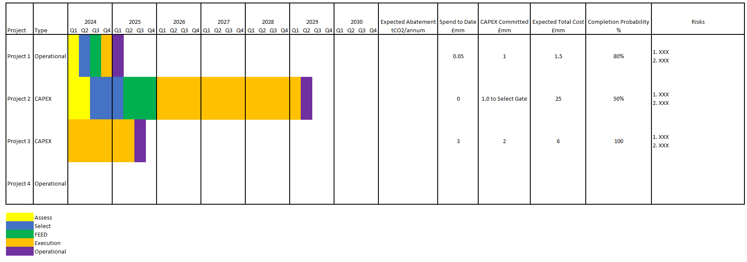
[Hub Name]: Emissions Reduction Project Program & Investments
[Hub Name]: Summarise Below
[Hub Name] Emissions Reduction Plan:
Categories of projects/ investments [Emissions reduction impact quantity range, Capex, Opex, Scale, Complexity, Timeline…]
Risks to progression
[Hub Name] Emissions Reduction Plan:
Project program to demonstrate progress, c/w project phases and Stage Gates milestones
EXAMPLE
Notes:
This slide should be updated by the Operator to provide a summary of the emissions reduction program including a supporting timeline.
An appropriate timeline should be shared in this slide demonstrating the timeline for each key ERAP commitment, emissions savings etc.
Stewardship Expectation 11 (Net Zero) should be referenced while populating this slide – https://www.nstauthority.co.uk/media/7184/se11_net-zero.pdf

Slide 9
[Hub Name]: Exploration Prospectivity (Add Multiple Slides for Additional Opportunities)
[Hub Name]: Exploration Opportunity xxx
Insert Appropriate Summary Picture for Exploration Opportunity
Field Map
Hub + Tie-Backs
Prospects, Discoveries & Fields in 30km Radius
Licence Acreage Held by JV
EXAMPLE
[Hub Name]: Exploration Opportunity xxx
Provide further information here on Exploration Opportunity
e.g. Location
e.g. Resources/STOIIP
e.g. Drilling Timing
e.g. Supply Chain/Procurement/Long Leads
Xxx
Xxx
xxx
Notes:
This slide is a template to summarise applicable exploration opportunities for the asset/hub.
The slide should include an appropriate graphic for the opportunity (top left), bullet point summary of the opportunity (bottom right) and supporting graphics/graphs to demonstrate the value of the exploration prospect.
If not applicable, this slide can be removed from the slide pack.
Multiple copies of this slide can be included if there are multiple exploration opportunities on the asset/hub.

Slide 10
[Hub Name]: Undeveloped Discoveries (Add Multiple Slides for Additional Opportunities)
[Hub Name]: Undeveloped Discovery xxx
Insert Appropriate Summary Picture for Undeveloped Discovery
Field Map
Hub + Tie-Backs
Prospects, Discoveries & Fields in 30km Radius
Licence Acreage Held by JV
EXAMPLE
[Hub Name]: Undeveloped Discovery xxx
Provide further information here on Undeveloped Discovery
e.g. Location
e.g. Resources/STOIIP
e.g. Drilling Timing
e.g. Supply Chain/Procurement/Long Leads
Xxx
Xxx
xxx
Notes:
This slide is a template to summarise applicable undeveloped discoveries for the asset/hub.
The slide should include an appropriate graphic for the opportunity (top left), bullet point summary of the opportunity (bottom right) and supporting graphics/graphs to demonstrate the value of the undeveloped discovery.
If not applicable, this slide can be removed from the slide pack.
Multiple copies of this slide can be included if there are multiple undeveloped discoveries on the asset/hub.

Slide 11
[Hub Name]: Infill/Workover Opportunities (Add Multiple Slides for Additional Opportunities)
[Hub Name]: Infill/Workover Opportunities
xxx
Insert Appropriate Summary Picture for Infill/Workover Opportunities
Field Map
Hub + Tie-Backs
Prospects, Discoveries & Fields in 30km Radius
Licence Acreage Held by JV
EXAMPLE
[Hub Name]: Infill/Workover Opportunities xxx
Provide further information here on Infill/Workover Opportunities
e.g. Location
e.g. Infill/Workover Scope
e.g. Infill/Workover Timing
e.g. Supply Chain/Procurement/Long Leads
Xxx
Xxx
xxx
Notes:
This slide is a template to summarise applicable infill/workover opportunities for the asset/hub.
The slide should include an appropriate graphic for the opportunity (top left), bullet point summary of the opportunity (bottom right) and supporting graphics/graphs to demonstrate the value of the infill/workover opportunity.
If not applicable, this slide can be removed from the slide pack.
Multiple copies of this slide can be included if there are multiple infill/workover opportunities on the asset/hub.

Slide 12
[Hub Name]: Enhanced Recovery Opportunities (Add Multiple Slides for Additional Opportunities)
[Hub Name]: Enhanced Recovery Opportunities xxx
Insert Appropriate Summary Picture for Enhanced Recovery Opportunities
Field Map
Hub + Tie-Backs
Prospects, Discoveries & Fields in 30km Radius
Licence Acreage Held by JV
EXAMPLE
[Hub Name]: Enhanced Recovery Opportunities xxx
Provide further information here on Enhanced Recovery Opportunities
e.g. Location
e.g. Scope
e.g. Timing
e.g. Supply Chain/Procurement/Long Leads
Xxx
Xxx
xxx
Notes:
This slide is a template to summarise applicable enhanced recovery opportunities for the asset/hub.
The slide should include an appropriate graphic for the opportunity (top left), bullet point summary of the opportunity (bottom right) and supporting graphics/graphs to demonstrate the value of the enhanced recovery opportunity.
If not applicable, this slide can be removed from the slide pack.
Multiple copies of this slide can be included if there are multiple enhanced recovery opportunities on the asset/hub.

Slide 13
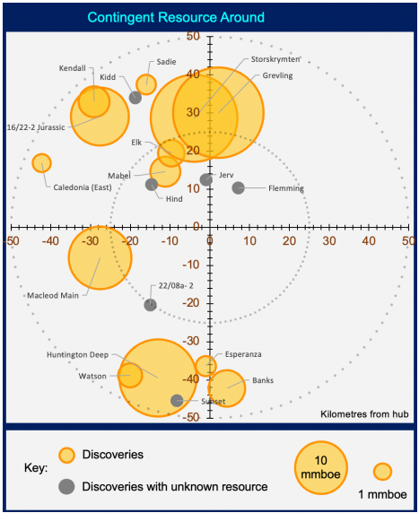
[Hub Name]: 3rd Party/Business Development Opportunities
[Hub Name]: 3rd Party/Business Development Opportunities
[Hub Name]: 3rd Party/Business Development Opportunities xxx
Provide further information here xxx
e.g. 50km radius around asset/hub
e.g. unlicenced opportunities
e.g. 3rd party/BD tie-back opportunities
e.g. carbon capture & storage
e.g. energy integration development/electrification
Xxx
xxx
EXAMPLE
3rd Party/Business Development Opportunities
Opportunity | Distance from Asset/Hub | Licence Owner/Operator | Volume | Status
Opportunity A | 5km | xxx | xxx | xxx
Opportunity B | 8km | xxx | xxx | xxx
Opportunity C | 13km | xxx | xxx | xxx
Opportunity D | 20km | xxx | xxx | xxx
Opportunity E | 35km | xxx | xxx | xxx
EXAMPLE
Notes:
The purpose of this slide is for the Operator to demonstrate all potential 3rd party or business development opportunities near the asset/hub have been considered.
If not applicable, this slide can be removed from the slide pack.

Slide 14
[Hub Name]: Topsides Projects (Add Multiple Slides for Additional Projects)
[Hub Name]: Topsides Project xxx
Insert Appropriate Summary Picture for Topsides Project
E.g. Project Picture, PFD or P&ID
Appropriate Summary Graphic (e.g. Production Profile)
EXAMPLE
Appropriate Summary Table (e.g. Project Concept Selection)
[Hub Name]: Topsides Project xxx
Provide further information here on Topsides Project here
e.g. Scope
e.g. Justification/Value
e.g. Location
e.g. Timing
e.g. Supply Chain/Procurement/Long Leads
Xxx
xxx
Options | CAPEX Estimate | Est. CAPEX Range | Outage Duration | Lead Time
Import Export Gas | £15m | £10m - £20m | 60 Days | 65 Days
New Fuel Gas Compressor | £8m | £4m - £15m | 50 Days | 78 Days
Dual Fuel Booster Comp. Turbine | £6m | £3m - £11m | 85 Days | 50 Days
EXAMPLE
Notes:
This slide is a template to summarise key topsides projects for the asset/hub.
This template can also be used to provide further information associated with any key emissions reduction/ERAP opportunities.
If not applicable, this slide can be removed from the slide pack.
Multiple copies of this slide can be included if there are multiple enhanced recovery opportunities on the asset/hub.

Slide 15
[Hub Name]: Barrel Adding Opportunities
[Hub Name]: Summarise Table Below
Opportunity | Description | Project Phase | Timing | Volume/Production | Comments
Well XXX | Velocity String | Engineering & Procurement | Q4 2024 | 10mmscfd Uplift
Well XXX | Isolate water producing interval | Detailed Design | Q1 2025 | TBC
Well XXX | Perforate new zone | Detailed Design | Q2 2025 | 5mboepd Uplift
Compressor Suction Pressure Reduction | Reduce Export Compressor suction pressure to improve well performance and reduce liquid loading | FEED | Q4 2025 | 10mmscfd Uplift
EXAMPLE
Notes:
This slide is a template to summarise key barrel adding opportunities for the asset/hub (e.g. well intervention, compression optimisation) including appropriate descriptions, timing and value of each opportunity.
Examples provided in the table are a guide only and the Operator should populate the table with applicable opportunities for the asset/hub.
If not applicable, this slide can be removed from the slide pack.

Slide 16
[Hub Name]: Production Efficiency/Debottlenecking Opportunities
[Hub Name]: Summarise Table Below
Theme | Opportunity | Status | Timing | Value / Risks
Optimise Current Installed Facilities | Optimise Gas Lift Optimise Water Injection Rates Reduce Compressor Suction Pressure | Ongoing Not Started Planned QX 20XX | Commenced QX 20XX Planned QX 20XX Delayed from QX 20XX | Increased Daily Production Rates / Increased PE
Debottlenecking | Increased Separator Capacity Compressor Anti-Surge Tuning Key Instrument Loop Tuning | Ongoing Not Started Planned QX 20XX | Commenced QX 20XX Planned QX 20XX Delayed from QX 20XX | Increased Daily Production Rates
Optimise Current Well Stock (e.g. Well Interventions) | Conduct Well Intervention Activities (e.g. CT) | Planned QX 20XX | Planned QX 20XX | Increased Daily Production Rates
Optimise Shutdowns/TARs | Remove Non-Critical Scope from Shutdown/TAR | Planned QX 20XX | Planned QX 20XX | Increased PE/Reduced Shutdown Time
EXAMPLE
Notes:
This slide is a template to summarise key debottlenecking and/or production efficiency improvement opportunities.
Examples provided in the table are a guide only and the Operator should populate the table with applicable opportunities for the asset/hub.
If not applicable, this slide can be removed from the slide pack.

Slide 17
[Hub Name]: Shutdown/TARs/Maintenance Backlog
Theme | Description | Value
Maintenance Backlog Opportunities | Conduct maintenance strategy optimisation review | Reduced maint backlog (xx hrs)
 | Adjust maintenance frequencies based on historical performance | Reduced maint backlog (xx hrs)
 | Cancel/remove maintenance for redundant/mothballed equipment | Reduced maint backlog (xx hrs)
 | Ensure correct maintenance coding (e.g. shutdown vs. non-shutdown) | Reduced maint backlog (xx hrs)
 | Investigate potential to increase tool time | Reduced maint backlog (xx hrs)
Shutdown/TAR Opportunities | Consider where certain scopes could be removed or integrated in base maint plan | Optimised Maint Strategy
 | More effective use of contractors | Reduced Vendor Spend
 | Improved job planning and execution | Additional Uptime/Prod
[Hub Name]: Summarise Below
[Hub Name] Shutdown/TAR/Maintenance Backlog optimisation:
Maintenance Backlog – strategy to manage/reduce, ensure maintenance scopes correctly coded (e.g. shutdown vs. non-shutdown)
Shutdown/TAR - investigate options to optimise frequency and scope (e.g. more effective use of contractors, improve planning/execution)
UKCS median shutdown/TAR performance is 12 days
Consider supply chain challenges/concerns
Consider regulator specific actions
EXAMPLE
SD Days:
23
21
21
21
30
21
21
EXAMPLE
Notes:
The purpose of this slide is to demonstrate optimisation associated with shutdowns/TARs and the asset/hub maintenance backlog management.
All information/graphics/tables on this slide can be updated by the Operator to appropriately demonstrate the Shutdown/TARs/Maintenance Backlog for the asset/hub.

Slide 18
[Hub Name]: Life Extension Opportunities
[Hub Name]: Summarise Below
[Hub Name] Late Life Strategy Summary
What?
High level summary of Late Life Strategy
Framing Document and Detailed Execution Plan?
Understand Why, How and What?
CoP & Decom Strategy?
Asset/Hub Economics?
Organisational readiness?
Accommodation support?
Key management systems & reporting mechanisms?
Surface history?
Well and subsea condition/integrity?
Process and utility systems (inc. power)?
Offtake and export routes?
Execution methodologies?
EXAMPLE
How?
Why?
Government drivers, regulations, business drivers, NTZC?
POB above normal ops?
Commercial structure and economics models?
HSE and Safety Case?
Inspection, maintenance, repair and mods performance/activities?
Frequency of assessment?
New fields and drilling?
Maximise economics recovery?
Other new tie-backs?
Original design life exceedance?
Safety Case material change?
Environmental drivers?
Notes:
This slide should be updated to demonstrate the late life strategy of the asset.
The bullet points provided in the template are a guide and can be included or deleted as necessary.
If not applicable, this slide can be removed from the slide pack.

Slide 19
[Hub Name]: Technology Requirements
[Hub Name]: Summarise Table Below
Theme | What? | When? | Value / Risks
Hydraulic Fracturing | Identify Fraccable Completions Online & Offline Fraccing Modelling & Prediction | Fraccing Trials Planned QX 20XX Next fracs plans for QX 20XX | Upside Mitigates Downside Reservoir Outcomes
Advanced Seismic Imaging | Quantitative Analysis Imaging Optimisation Microseismic Monitoring for Fracs | Advanced Seismic Planned QX 20XX Improved Imaging Processing QX 20XX | Various (e.g. sidetrack cost savings, optimised well targets)
Well Drilling & Completions Optimisation | Zonal Isolation Remotely Frackable Sleeve Completions | Potential Zonal Isolation QX 20XX Potential Deployment 20XX+ | Supports Fraccing & Interventions Mitigations Against Water Breakthrough
Well Interventions | Water Shutoff Technologies | Well Intervention Activities Planned QX 20XX Trials Planned QX 20XX | PLT Cost Saving Well Optimisation
Remote & Digital Operations | Production Operator Workbench Production Optimisation Tools | In Use Since QX 20XX | Potential POB Reduction
Reservoir Modelling | Modelling for Uncertainty Range Prediction Natural Fracture Scenario Modelling | Modelling to be Deployed 20XX Natural Fracture Modelling Planned 20XX+ | Optimised Well Targets
EXAMPLE
Notes:
This slide should be updated to demonstrate technology opportunities on the asset/hub.
The examples/bullet points provided in the template are a guide and can be included or deleted as necessary.
If not applicable, this slide can be removed from the slide pack.

Slide 20
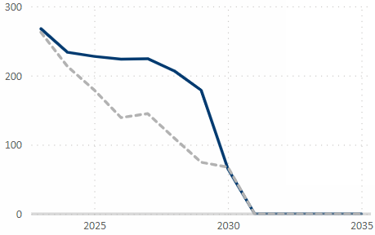
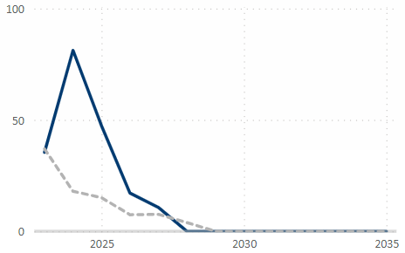
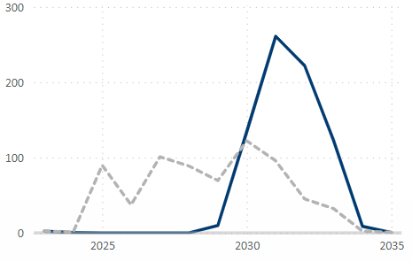
[Hub Name]: OPEX/CAPEX/ABEX
[Hub Name]: Summary of asset/hub OPEX/CAPEX/ABEX including risks & opportunities
Summary
OPEX
Summary of asset/hub OPEX/CAPEX/ABEX
Examples to consider:
Opportunities
Risks
Commercial
Finance
Partner/JV alignment
Unit Operating Cost (UOC)
OPEX Summary
Xxx
Xxx
Xxx
EXAMPLE
CAPEX
ABEX
CAPEX Summary
Xxx
Xxx
Xxx
ABEX Summary
Xxx
Xxx
Xxx
EXAMPLE
EXAMPLE
Notes:
This slide should be updated to summarise the OPEX, CAPEX and ABEX of the asset/hub including opportunities, risk etc.
The bullet points and graphics provided in the template are a guide and can be included or deleted as necessary.
Commercially or financially sensitive information should be removed from this slide prior to sharing out with the JV.

Slide 21
[Hub Name]: Decom Preparation & Post CoP Options
[Hub Name]: Summarise Below
Pre-Cessation of Production: APPRAISE, ASSESS and DEFINE
Activity | What? | When?
APPRAISE: Late Life Operating & Decommissioning Strategy | Late Life Operating Philosophy & Decom Concept Development L1 schedule and preliminary cost estimate Stakeholder Engagement Plan & Subsurface Basis of Design | 3 to 6 years prior to CoP
ASSESS: Regulatory & Development of Decommissioning Plan | Reuse/repurposing consideration and Decommissioning Programme approved by OPRED Develop Decom plans (concept selection and early engineering) Identify scope aggregation / campaign opportunities Contracting Strategy & refined cost estimate (Class 3) & schedule | 2 to 3 years prior to CoP
DEFINE: Detailed Engineering, Contract Award & Early Execution | Detailed engineering (incorporating lessons learnt & technology assessment) EPRD (and other) tender and contract award Pre-cessation scope execution (e.g. P&A of shut-in wells) Refined cost estimate (Class 2) & schedule | 1 to 3 years prior to CoP
EXAMPLE
Post-Cessation of Production: EXECUTE
Activity | What? | When?
EXECUTE: Implement Decommissioning Plan per approved Decommissioning Programme | Flush, clean and disconnect pipelines & umbilicals, engineer down and clean topside Plug & abandon platform & subsea wells, transition facility into cold stack Removal and disposal of platform and subsea infrastructure Pipeline & seabed remediation and close-out surveys, ongoing monitoring Cost and schedule monitoring | As per plan To minimise post-cessation running costs
Notes:
This slide should be updated to decommissioning preparation activities and post cessation of production opportunities for the asset/hub.
Through the NSTA Stewardship process, the Operator/JV will need to demonstrate they have maximised economic recovery from the area/hub and cost efficient readiness for cessation of production to minimise unnecessary post CoP operational expenditure.
The bullet points provided in the template are a guide and can be included or deleted as necessary.
Stewardship Expectation 10 (Cost Effective Decommissioning) should be referenced while populating this slide – https://www.nstauthority.co.uk/media/5904/oga_se10_cost_effective_decommissioning_july_2019.pdf
If not applicable, this slide can be removed from the slide pack.

Slide 22
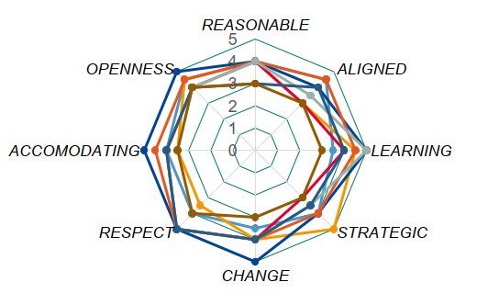
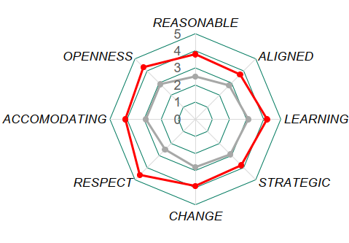
[Hub Name]: JV Collaboration & Alignment
[Hub Name]: Summary slide to demonstrate collaboration between JV Partners
Collaboration – Summary
CBQT Output
High level summary of Collaboration & CBQT
JV Partners?
Pipeline Operators?
Shippers/Terminals?
Nearby Asset/Hub Operators?
Supply Chain Challenges?
Collaboration – Focus Area & Action Plans
EXAMPLE
Focus Area | Specific Actions | Timeline
JV Framing Sessions on Strategic Issues | Long Term Plan – share assumptions with JV Partners to support budget/business planning | Q2 2024
Partner Workshops | Independent review of 2024 shutdown/TAR | Q1 2024
Partner Workshops | Asset Risk Register – share with JV Partners for input | Q1 2024
JV Hub Strategy | Commence asset life extension study to achieve CoP beyond 2030 | Q3 2024
JV Hub Strategy | Explore additional 3rd party tie-back opportunities to the asset | Q2 2024
Notes:
This slide should be updated to demonstrate appropriate JV collaboration and alignment for the asset/hub.
The bullet points/tables/graphics provided in the template are a guide and can be included or deleted as necessary.
Key interfaces outside the JV should be considered (e.g. shippers/terminals, nearby assets/operators, supply chain challenges/constraints).
If not applicable, this slide can be removed from the slide pack.

Slide 23
[Hub Name]: Development Scenario Analysis
[Hub Name]: Summary of Development Scenario Analysis
Base Case + Development Scenarios / Variations
Development Scenarios Overview
Base Case & key variations included for the Scenarios
Examples of variations to consider:
Improved / delayed drilling performance
Increased / decreased reserves (per well or P10/50/90)
Additional wells / successful EOR trial
Successful satellite developments
Reduced / increased cost (capex/opex)
Life time extension / decarbonisation
Scenarios → Variations ↓ | Base | 1 | 2 | 3 | 4 | 5
Reserves | P50
EOR | No
No wells | 25
Satellite | 1
Cost | P50
EXAMPLE
Scenario Outputs
Conclusions Scenario Analysis
Scenario | NPV mln GBP | Δ NPV mln GBP | Reserves mln GBP | Capex mln GBP | Opex mln GBP | First Oil
Base
1
2
3
4
Key conclusion Scenario Analysis work
Notes:
This slide should be populated in conjunction with slide 2 (Hub Timeline/Multi Scenario Plan).
The purpose of this slide is to provide further information associated with various scenarios for the asset/hub.
The bullet points/tables/graphics provided in the template are a guide and can be included or deleted as necessary.

Slide 24
JV Hub Strategy – Good Practice Matrix
Slide | Pre-Production Phase | Early Production Phase | Mid Production Phase | Late Production Phase | Post-Production Phase
Hub Strategy 1-Page Summary (Slide 1) | P | P | P | P | P
Hub Timeline (Slide 2) | P | P | P | P | P
SWOT Analysis (Slide 3) | P | P | P | P | P
MAH Prevention/Process Safety (Slide 4) | P | P | P | P | P
Emissions Baseline, Forecasts and Targets (Slide 5) | P | P | P | P | O
Emissions Reduction Project Program & Investments (Slide 6) | P | P | P | P | O
Exploration Prospectivity (Slide 7) | P | P | P | ? | O
Undeveloped Discoveries (Slide 8) | P | P | P | ? | O
Infill/Workover Opportunities (Slide 9) | ? | P | P | ? | O
Enhanced Recovery Opportunities (Slide 10) | P | P | P | ? | O
3rd Party/Business Development Opportunities (Slide 11) | P | P | P | ? | O
Topsides Projects (Slide 12) | ? | P | P | P | O
Barrel Adding Opportunities (Slide 13) | ? | P | P | P | O
Production Eff./Debottlenecking Opportunities (Slide 14) | ? | P | P | P | O
Shutdown/TARs/Maintenance Backlog (Slide 15) | P | P | P | P | O
Life Extension Opportunities (Slide 16) | ? | ? | P | P | O
Technology Requirements (Slide 17) | P | P | P | P | P
OPEX/CAPEX/ABEX (Slide 18) | P | P | P | P | P
Decom Preparation & Post CoP Options (Slide 19) | ? | ? | P | P | P
JV Collaboration & Alignment (Slide 20) | P | P | P | P | P
Development Scenario Analysis (Slide 21) | P | P | P | P | ?
Notes:
This slide has been included as a guide for the Operator/JV to determine which slides are applicable for the asset/hub dependent on the stage in their lifecycle.
This matrix should be treated as a guide and the Operator/JV should decide which slides are applicable to their asset/hub.

Slide 25
Backup/Supplementary Slides
*Optional*
Notes:
This section of the slide pack/template is optional – further slides can be added in the backup to support for detail in the JV Hub Strategy if necessary

